Slide 1

MachineLearning Spambase
How to get more accuracy
Background
About Dataset
What to do?
Method
Other Project
Kyubin Kyoung
Result/Comparison
2013104046 Computer Engineering
Conclusion

Slide 2
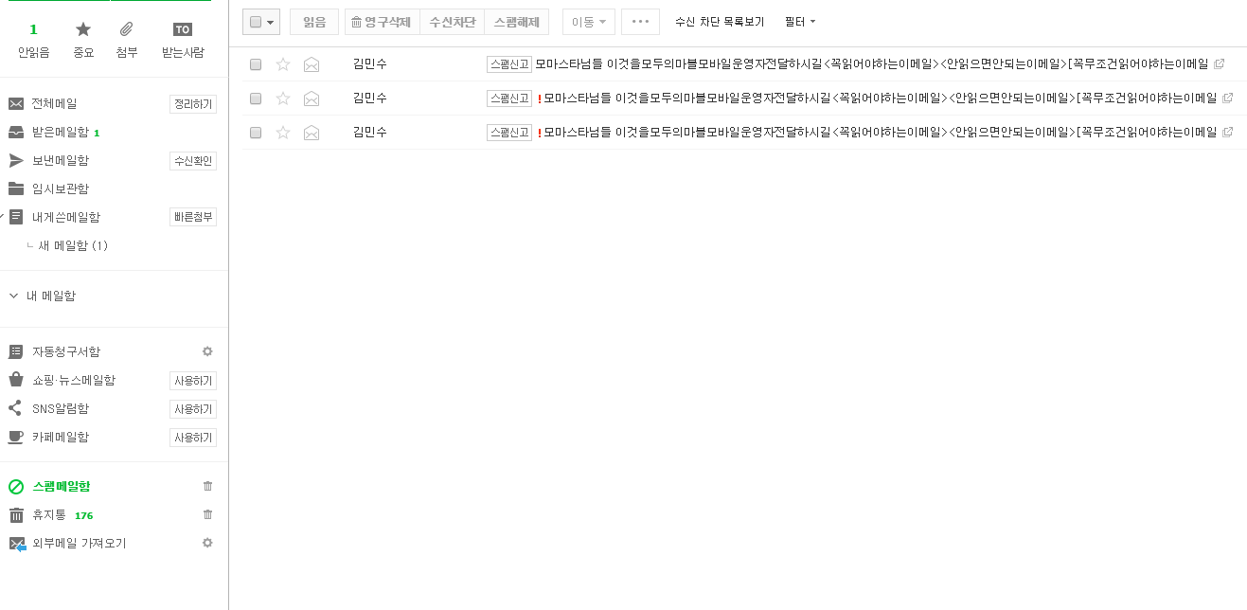
Background
01
So many Spam Mails

Slide 3
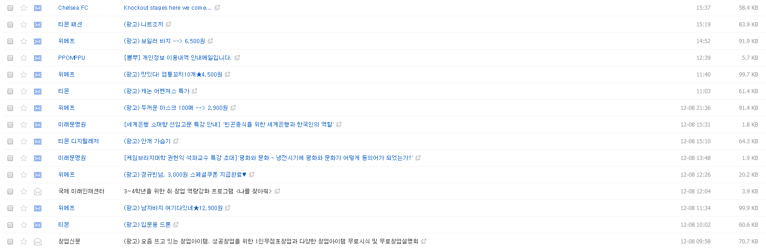
Background
01
Why Are the Spams in Normal Mailbox?

Slide 4

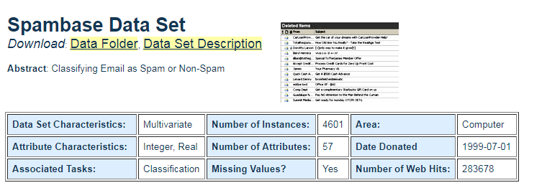
About Dataset
02
UCI
Spambase

Slide 5
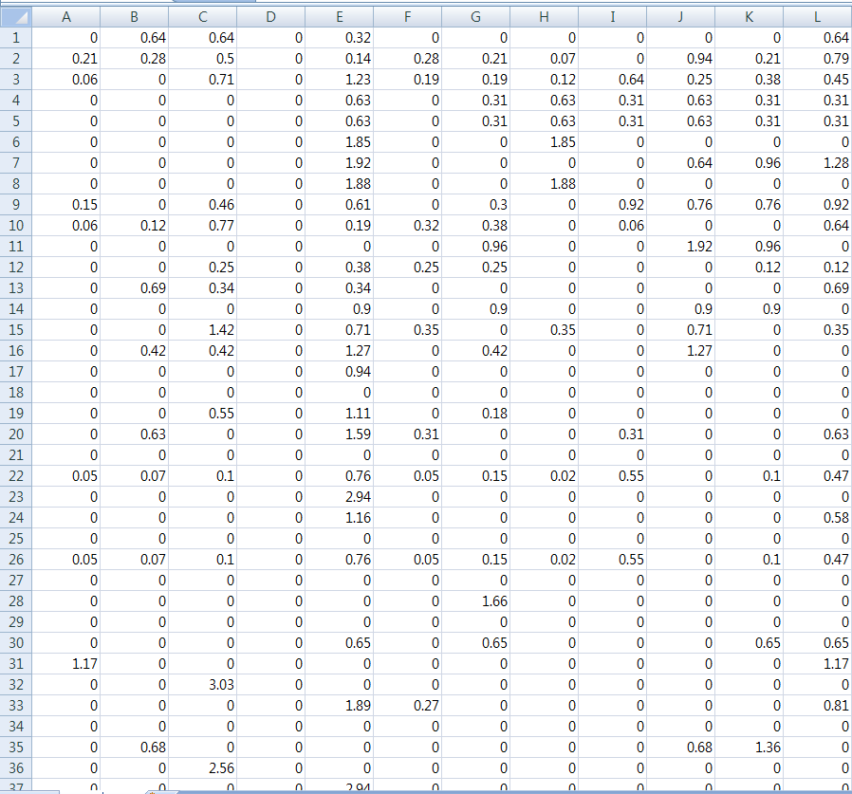
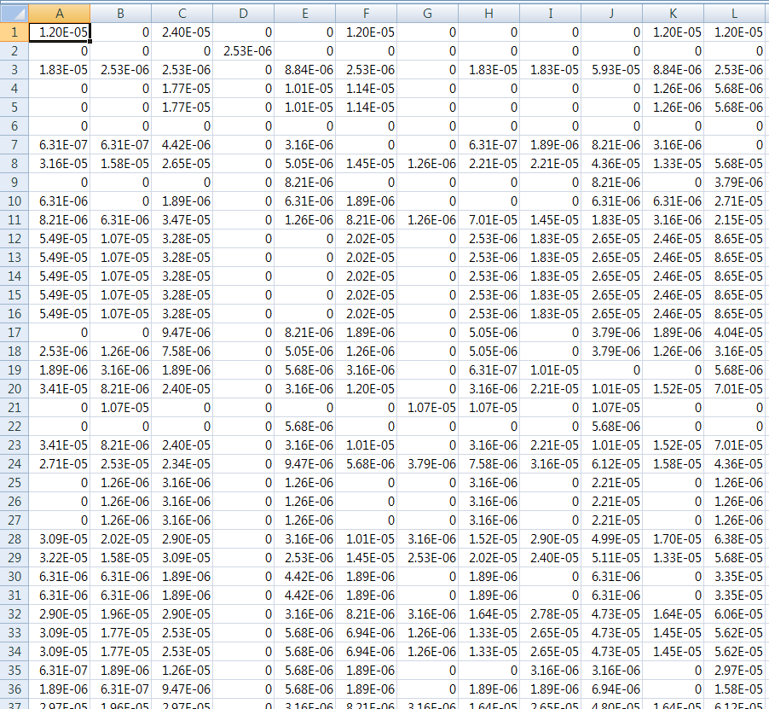
About Dataset
02
Normalization

Slide 6
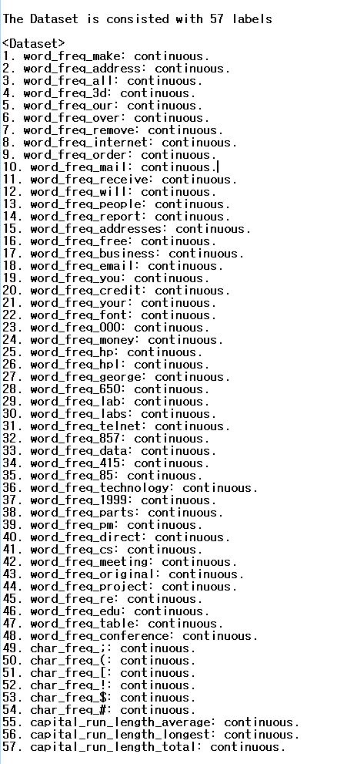
About Dataset
02
48 Word Frequency
6 Character Frequency
Capital_run_length_average
Capital_run_length
Capital_run_total

Slide 7
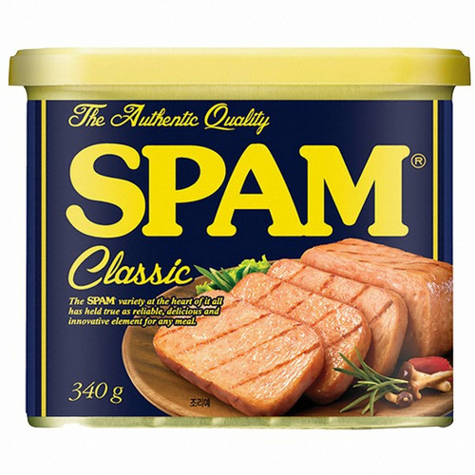
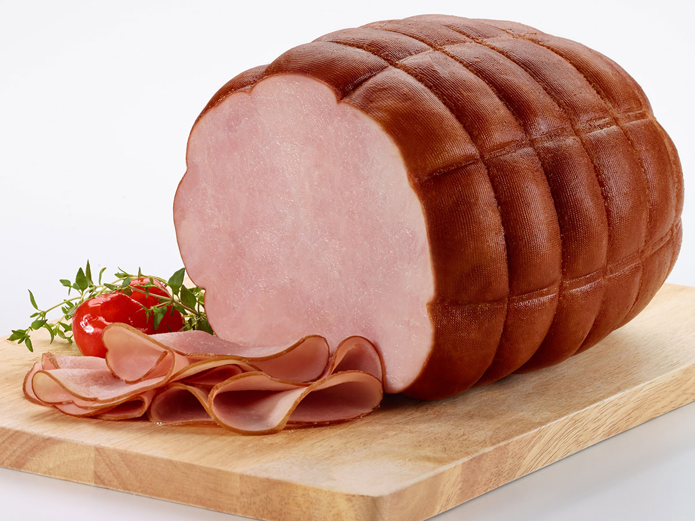
About Dataset
02
HAM
2 Classes

Slide 8
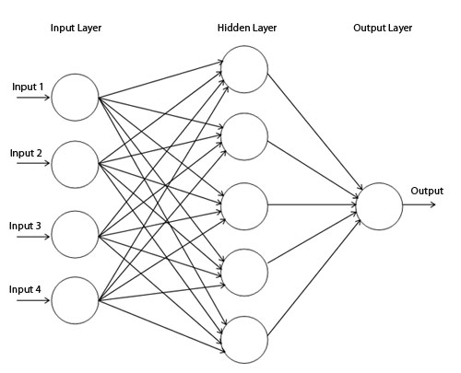
What to do?
03
Get Precision
Spambase
Input
MLP
Higher Accuracy

Slide 9
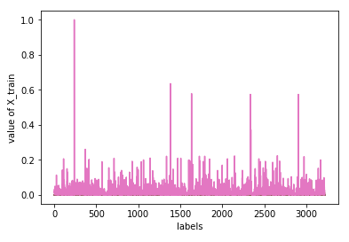
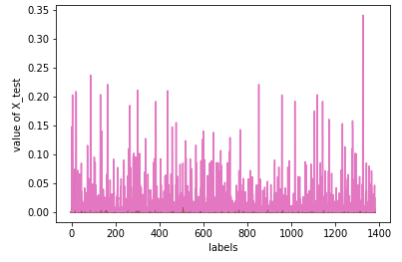
Methods
04
7
3
3220 training sets
1381 test sets

Slide 10
Methods
04
One hot Encoding
xavier_initializer
relu
5 Hidden Layers

Slide 11
Methods
04
Optimizer | Accuracy
AdadeltaOptimizer | 0.605358
AdagradOptimizer | 0.605358
AdamOptimizer | 0.917451
FtrlOptimizer | 0.605358
ProximalGradientDescentOptimizer | 0.605358
Used AdamOptimizer

Slide 12
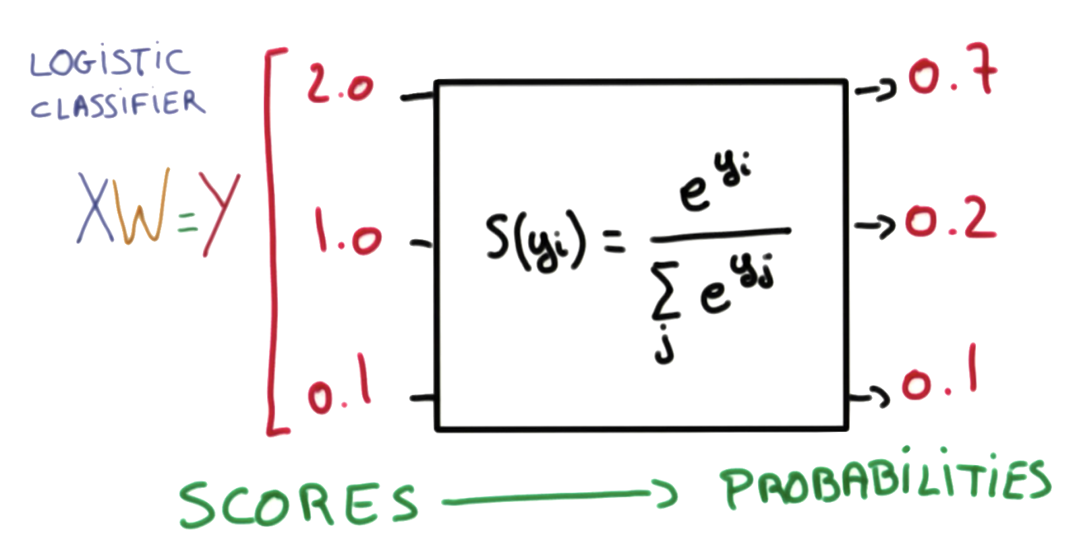
Other project
05
https://github.com/sampepose/SpamClassifier/blob/master/my_test.py
https://github.com/JonathanKross/spambase/blob/master/spamalot.ipynb
Multinominal Regression

Slide 13
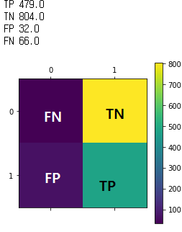
Result
06
Precision = TP / TP + FP
The precision is 0.937378

Slide 14
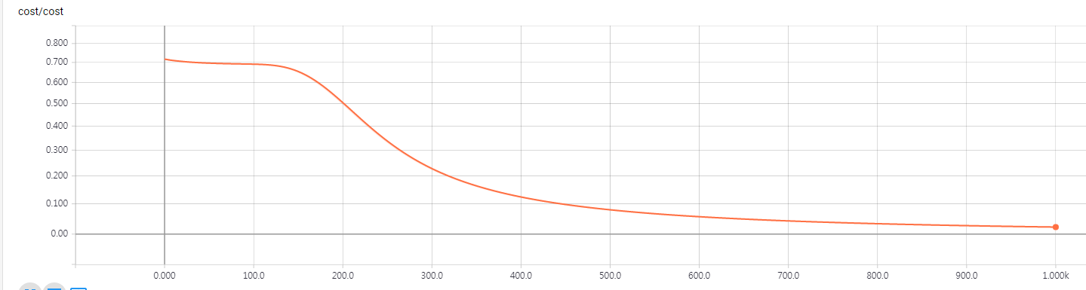
Result
06
 | test 1 | test 2 | test 3 | test 4 | test 5 | test 6 | test 7 | test 8 | test 9 | test 10 | Average
Accuracy | 0.87618 | 0.91962 | 0.92614 | 0.90804 | 0.90949 | 0.90587 | 0.8979 | 0.88776 | 0.92324 | 0.85735 | 0.90116
precision | 0.77994 | 0.87031 | 0.89065 | 0.87726 | 0.91177 | 0.8634 | 0.85943 | 0.8066 | 0.88307 | 0.8283 | 0.85707
Recall | 0.95596 | 0.93578 | 0.92661 | 0.89174 | 0.85321 | 0.90459 | 0.88624 | 0.94128 | 0.92844 | 0.80551 | 0.90294

Slide 15
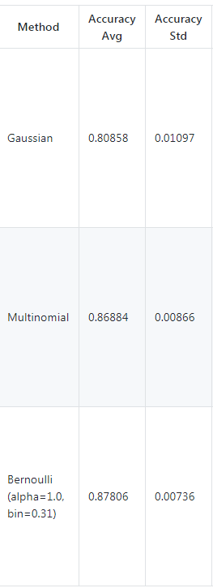
Comparison
07
Gaussian Accuracy: 0.808000
Multinominal Accuracy: 0.87230
Bernoulli Accuracy: 0.89164

Slide 16
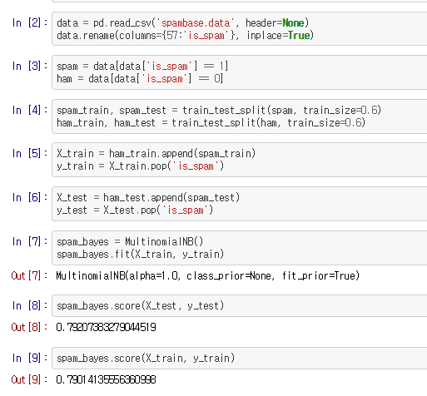
Comparison
07
Train_size = 60%
Accuracy = 79%

Slide 17
Conclusion
07
King God MLP

Slide 18
Thank You

